Slide 1
New York subway system
Presented by: Saksham Chandrawat
Disha Shah
Sheetal Nikam
Shruti

Slide 2
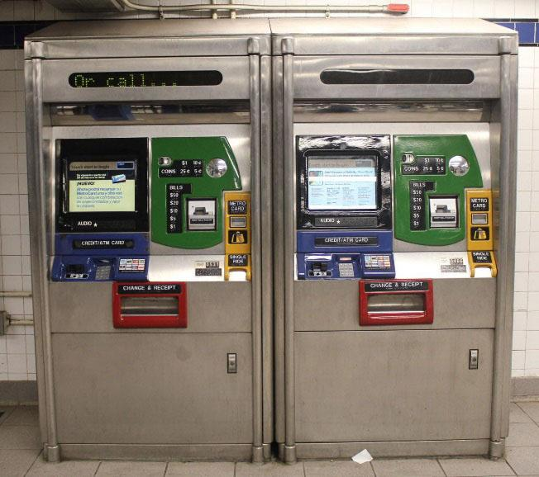
MetroCard Vending Machine

Slide 3
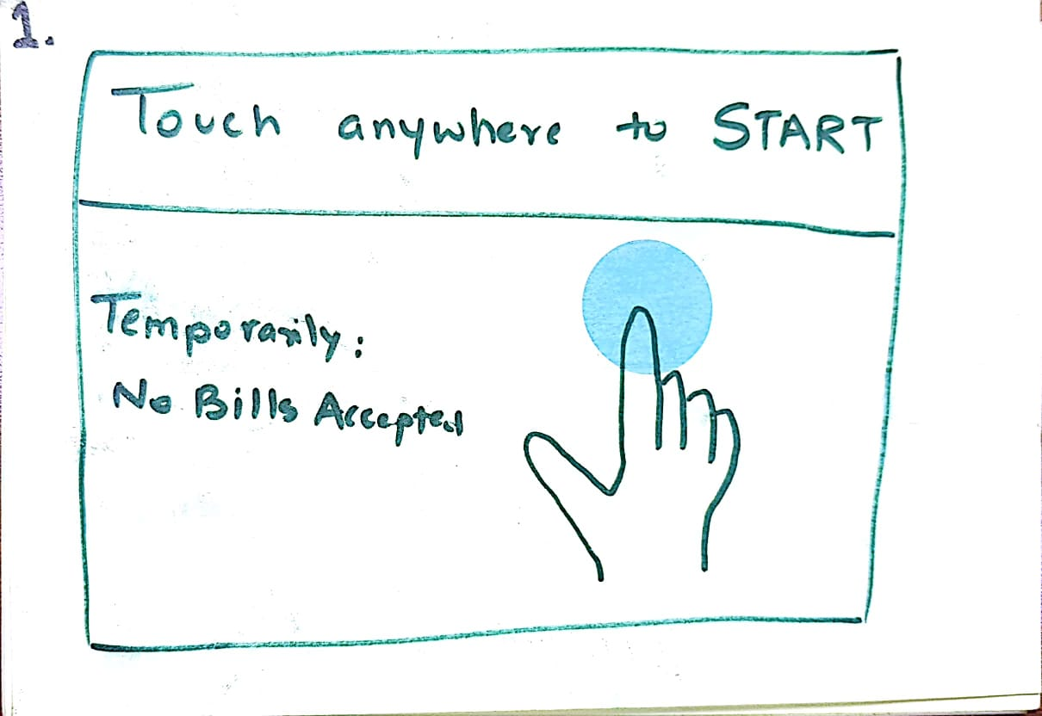
New interface look like:

Slide 4
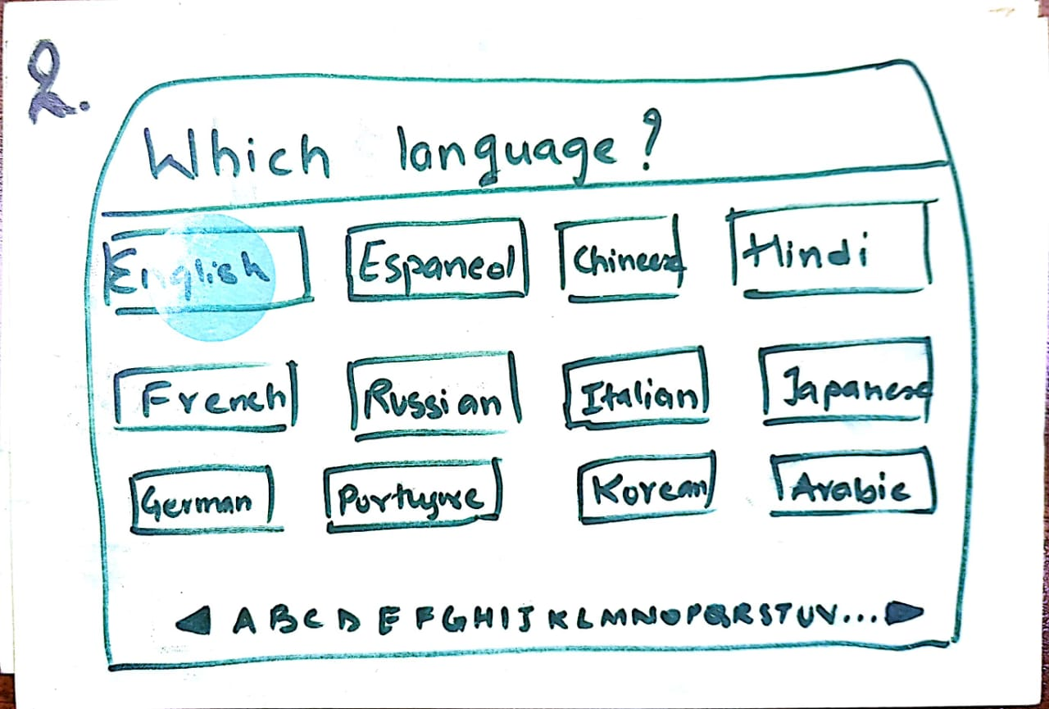

Slide 5
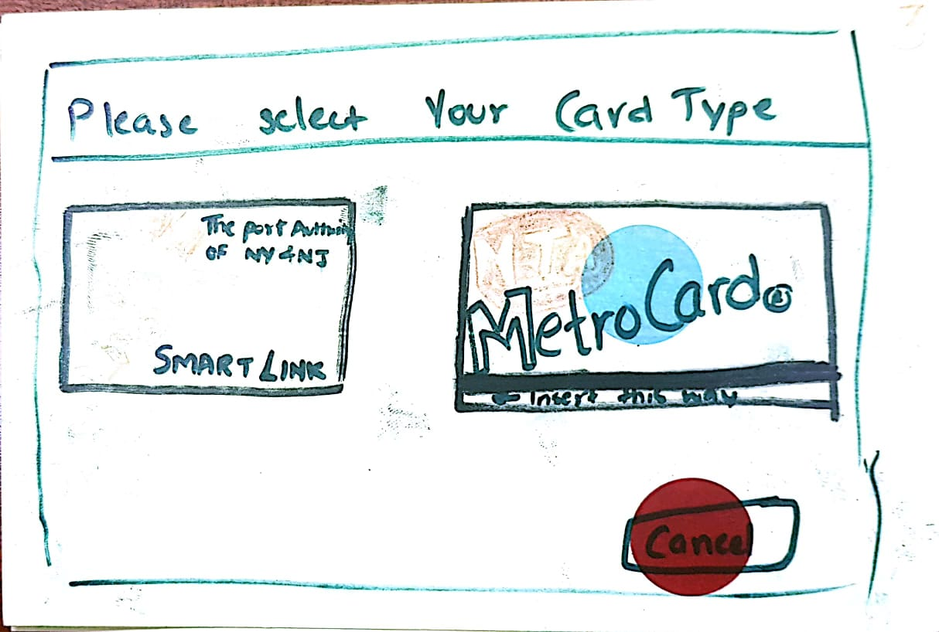

Slide 6
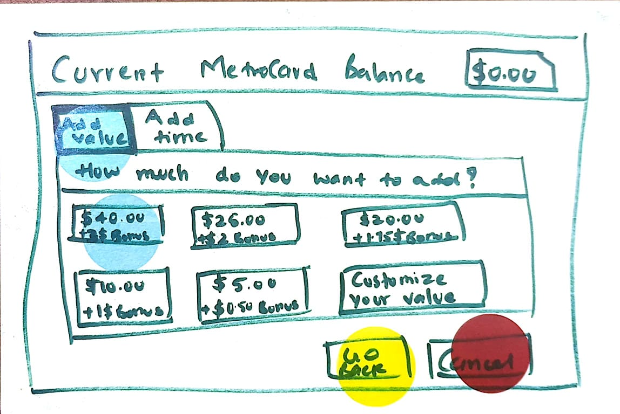

Slide 7
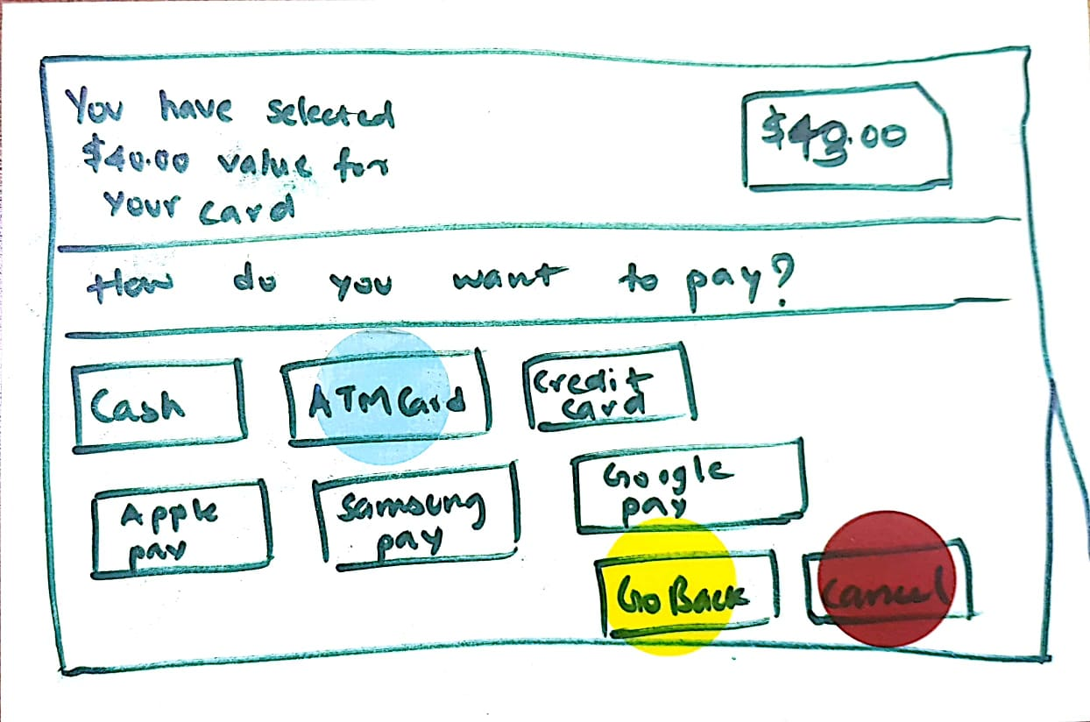

Slide 8
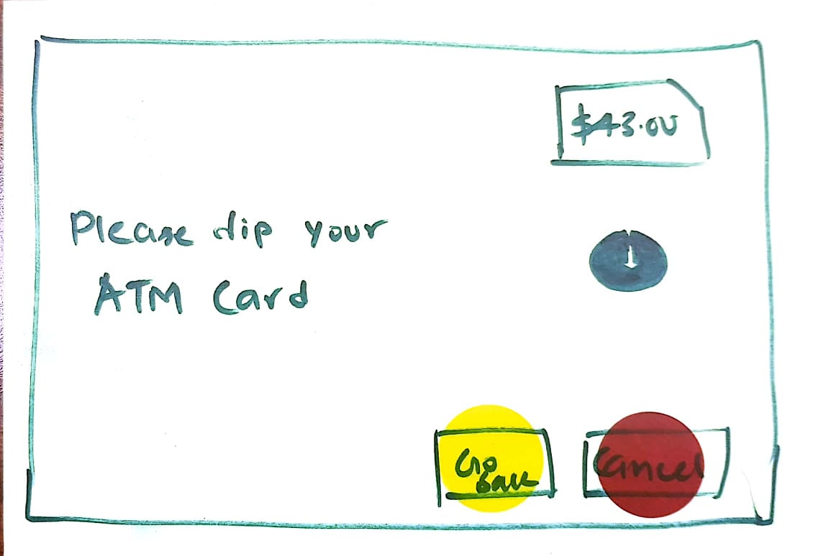

Slide 9
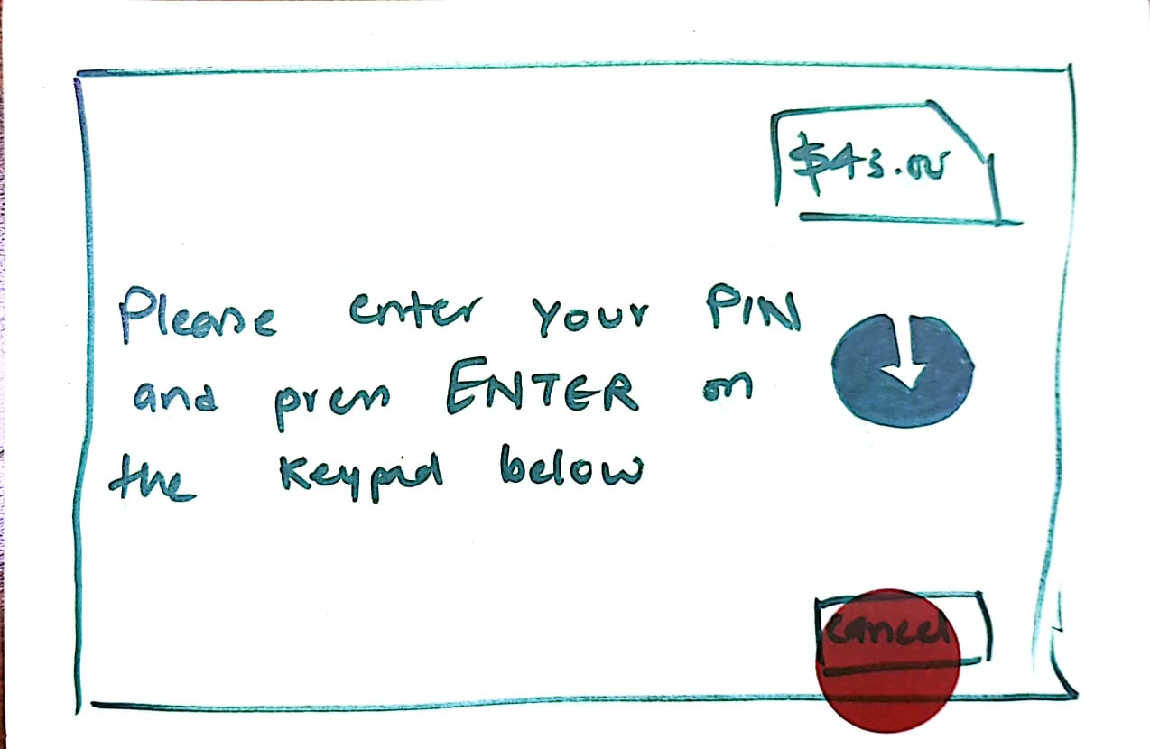

Slide 10
THANK YOU FOR USING OUR SERVICE KINDLY COLLECT YOUR RECEIPT

Slide 11
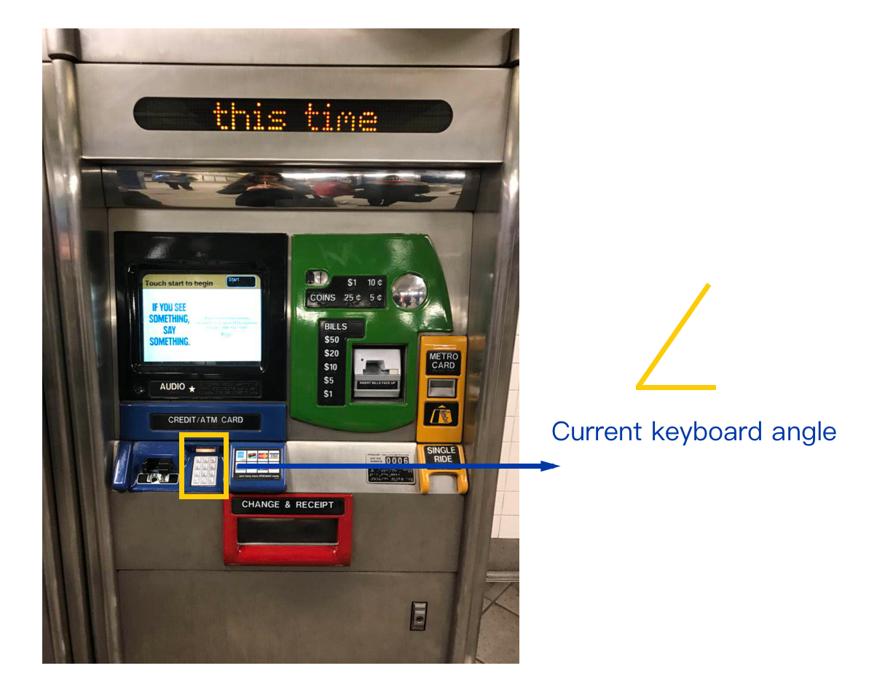
Some Hardware changes:

Slide 12
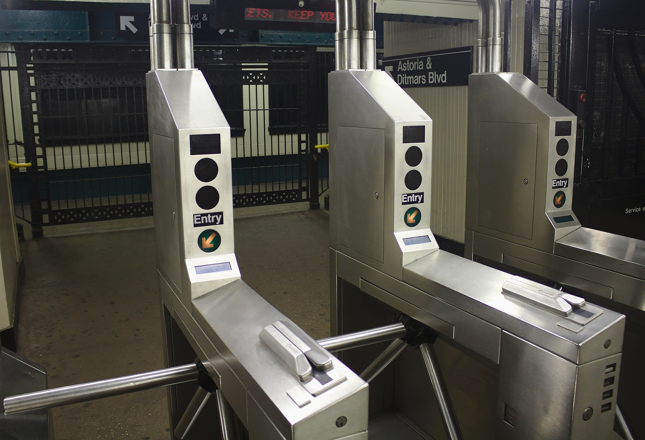
Turnstile
Display should be more clear and sharp.
We can use RFID that will work fast.
QR code scanning.

Slide 13
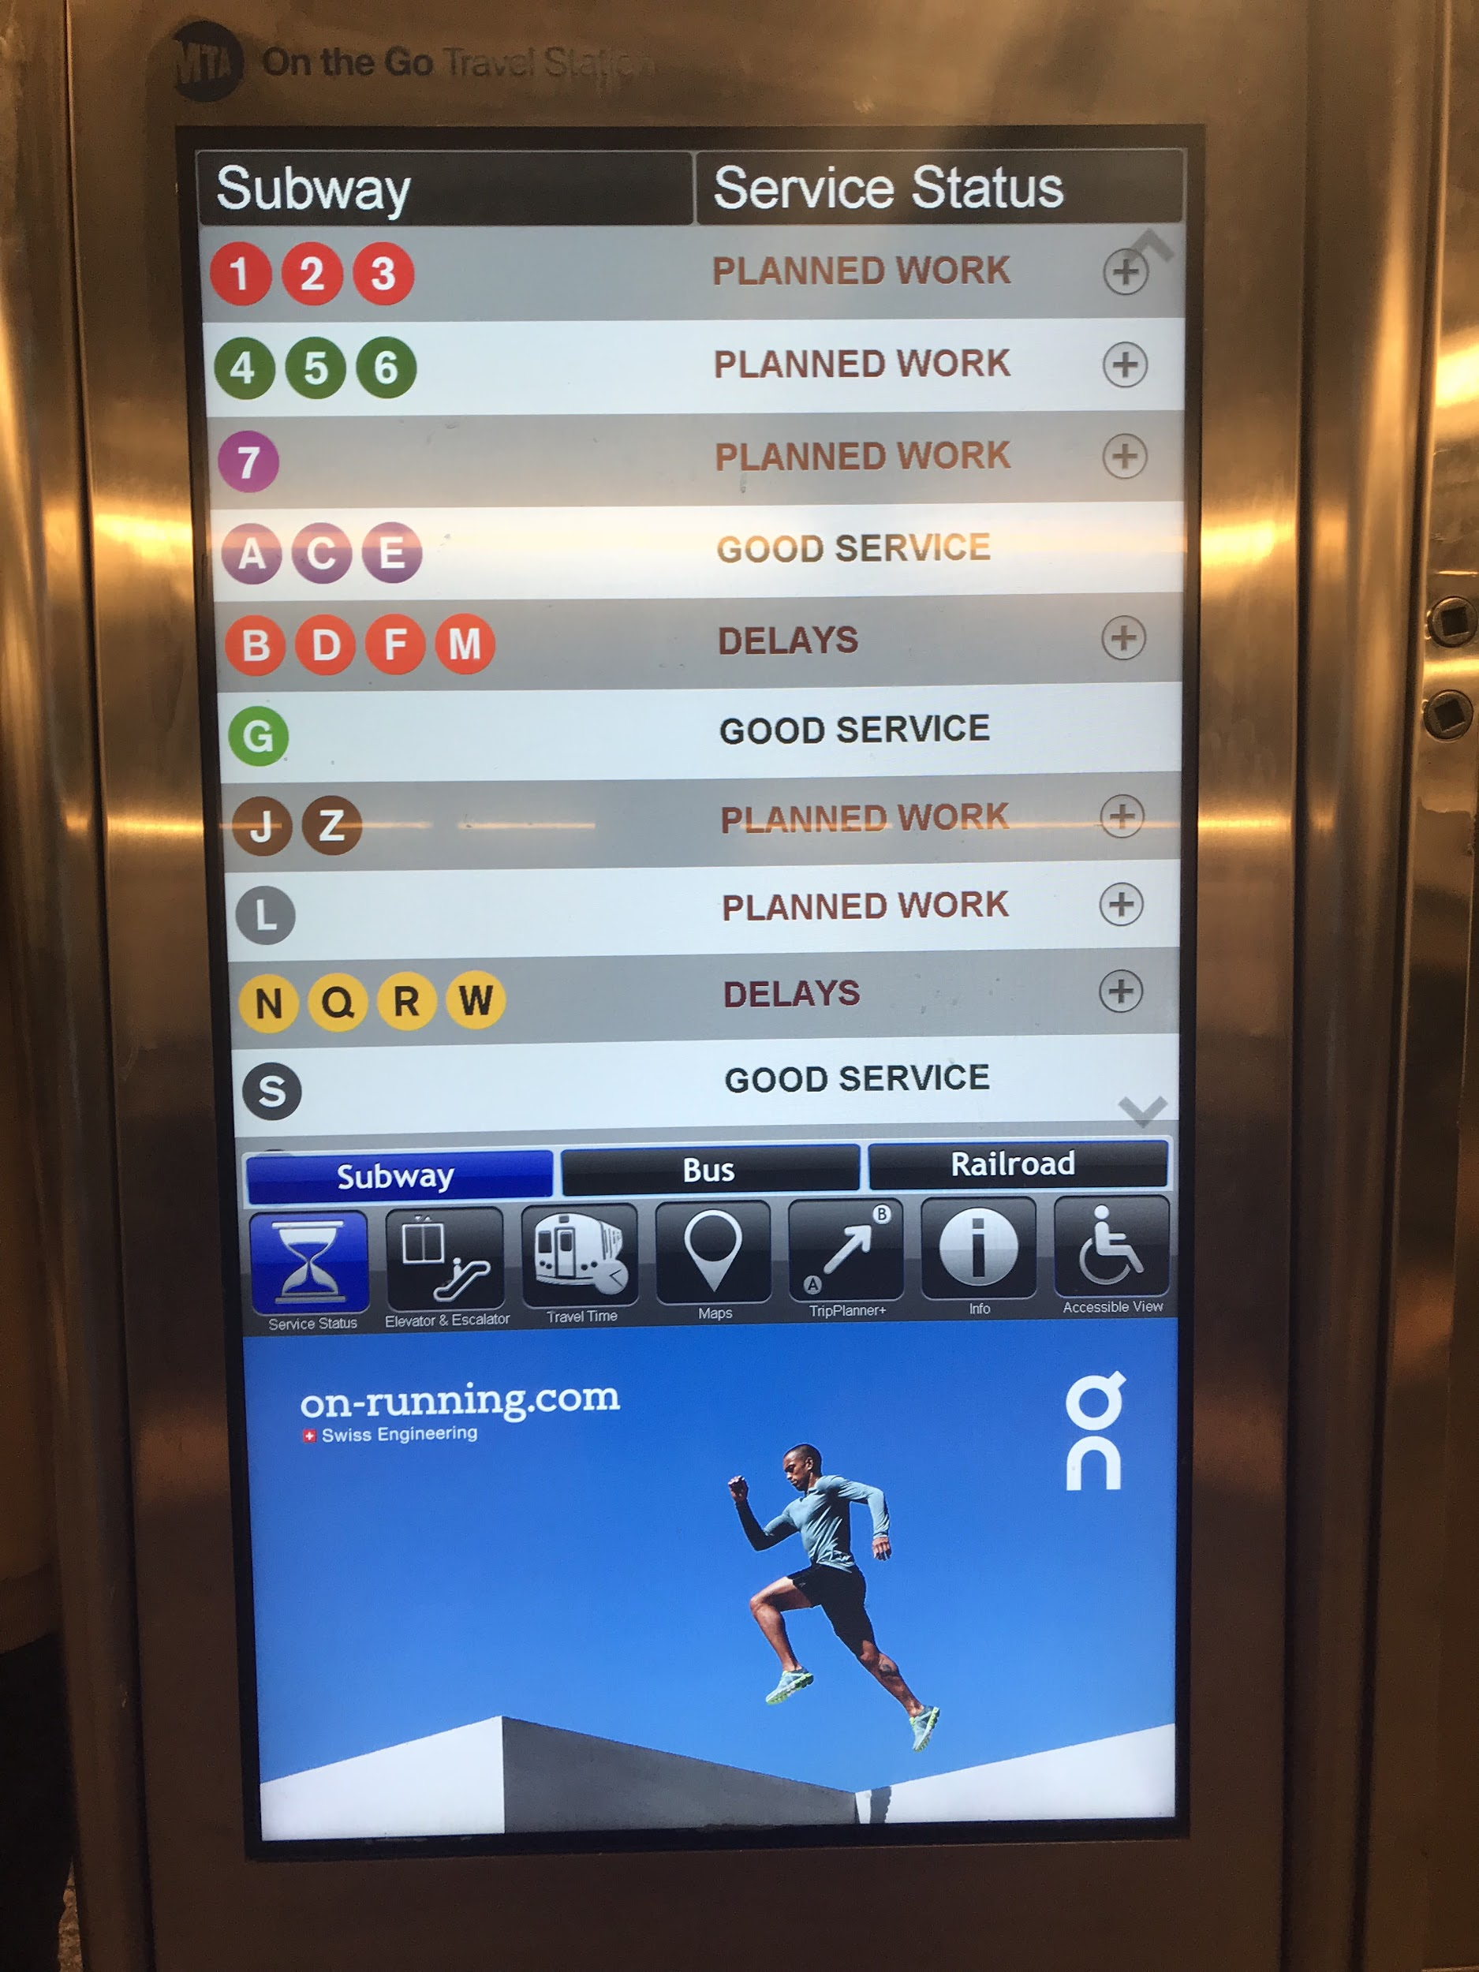
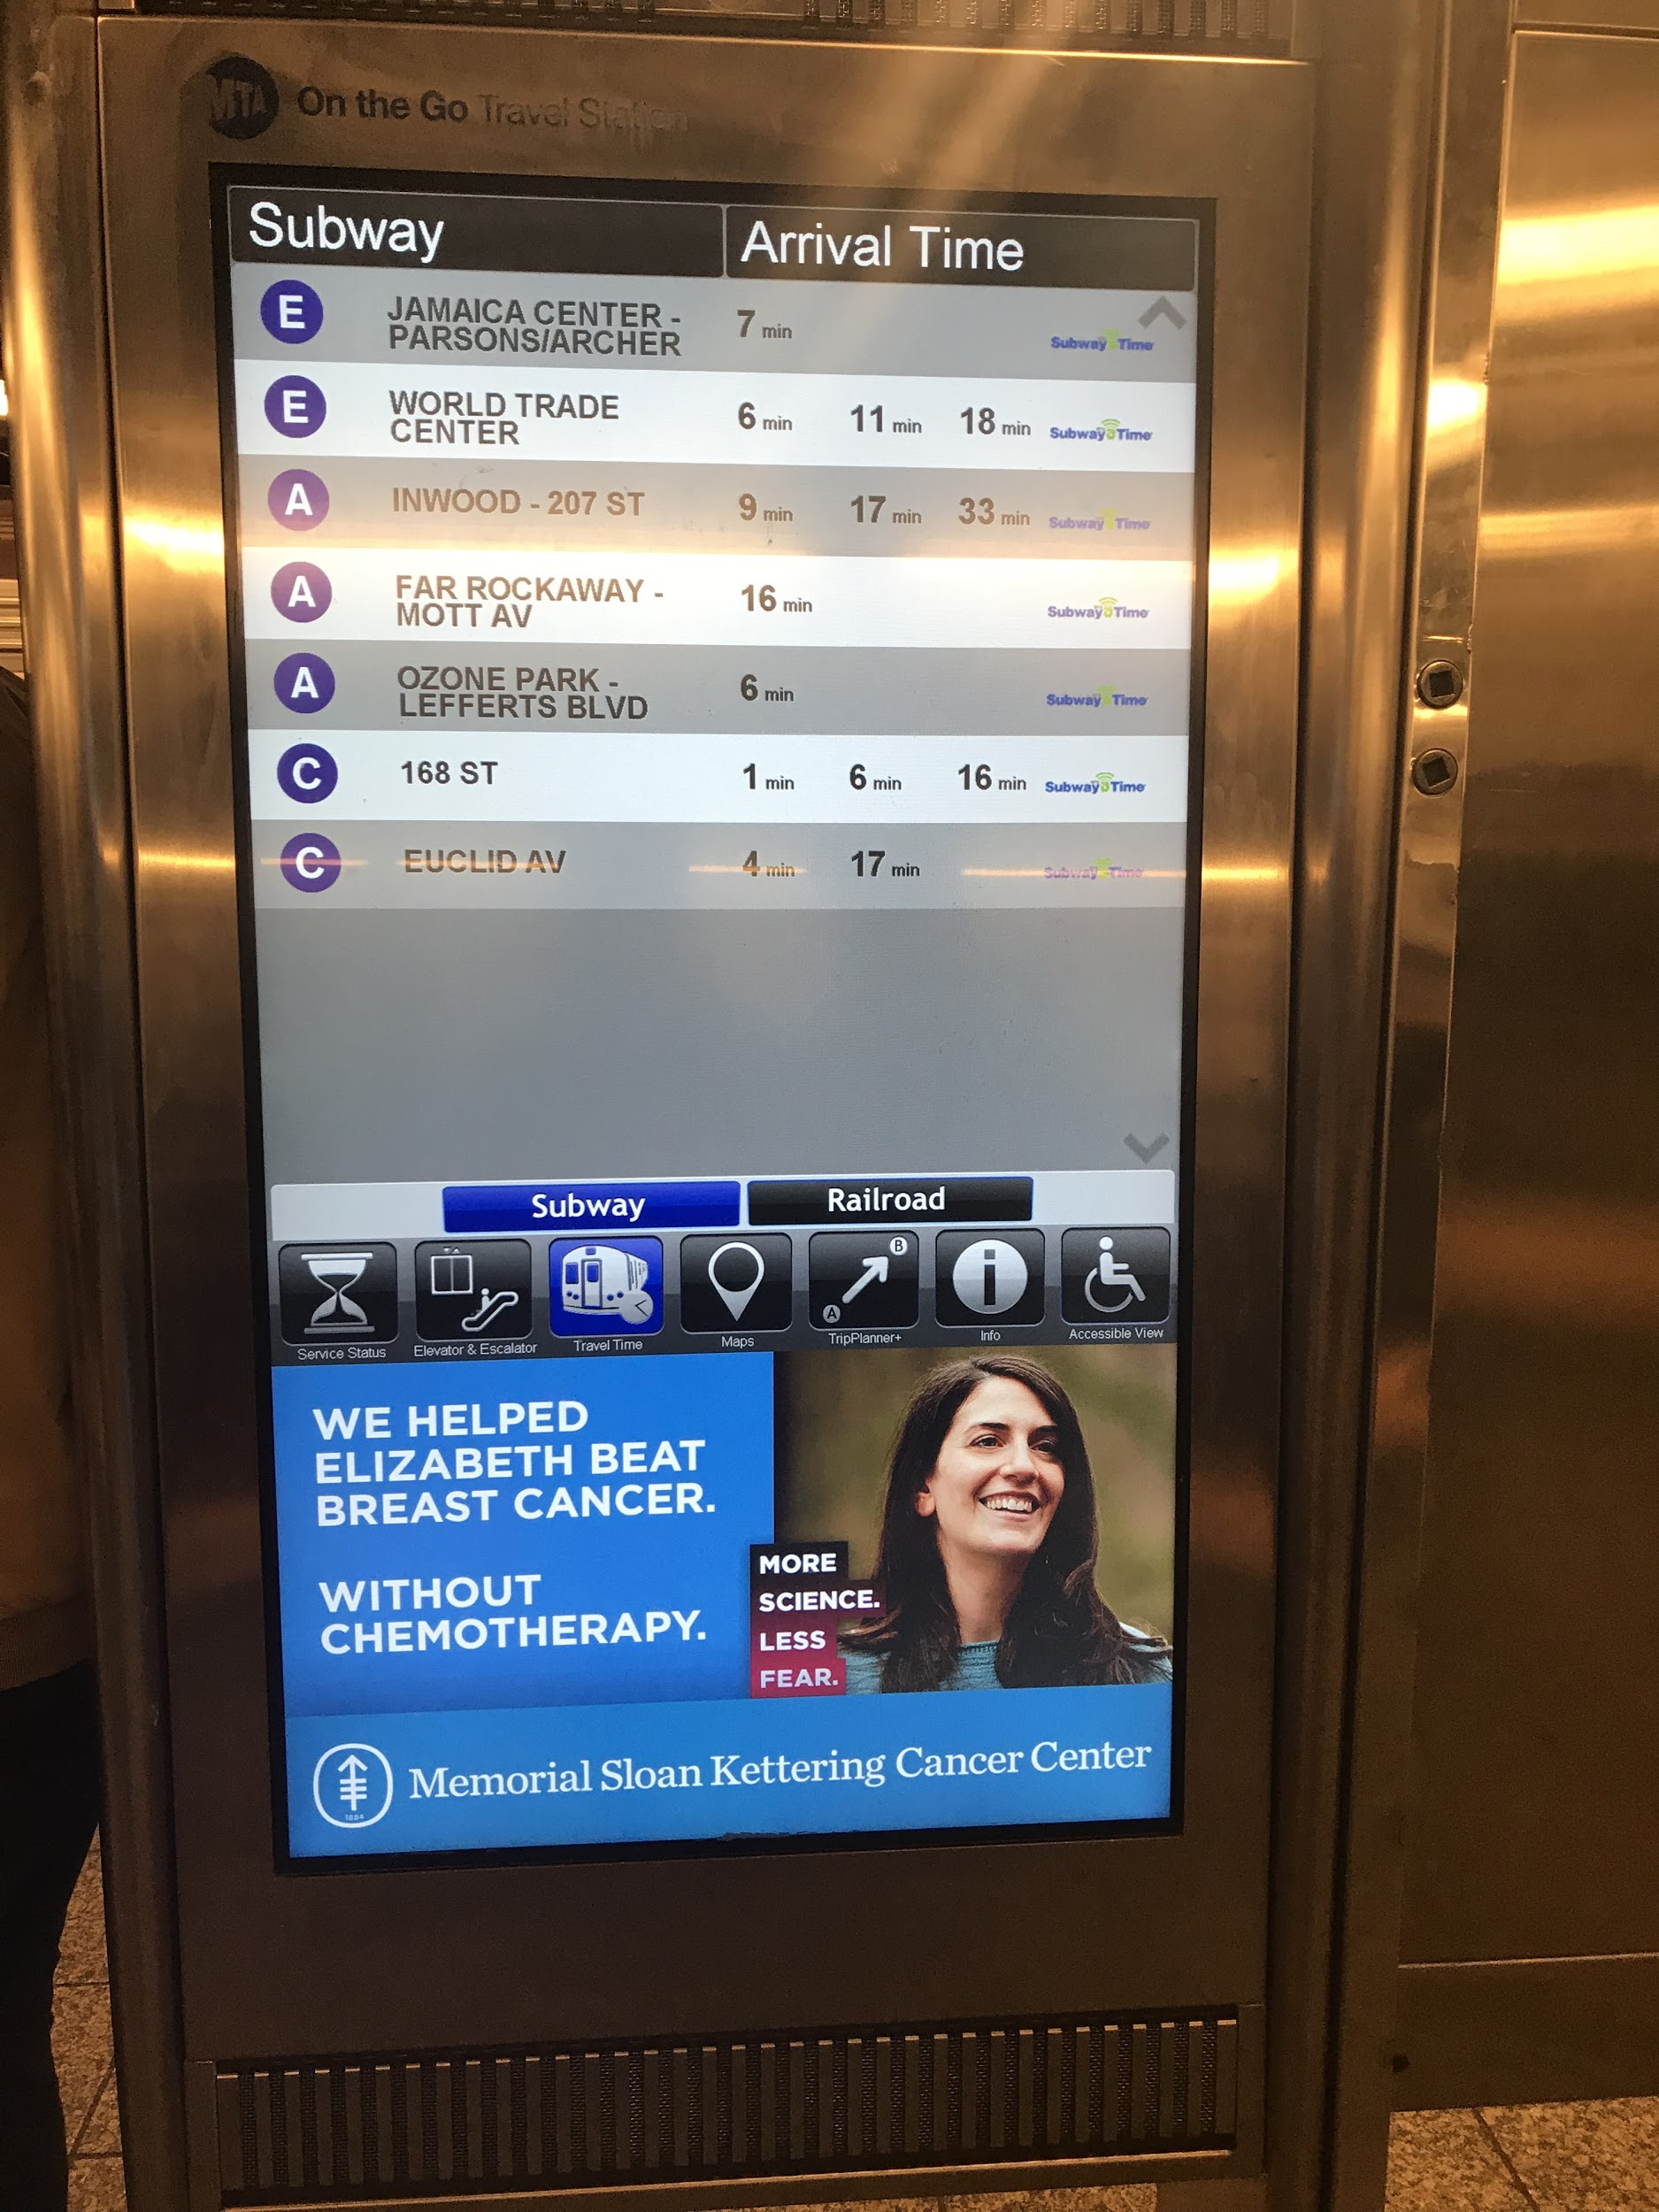
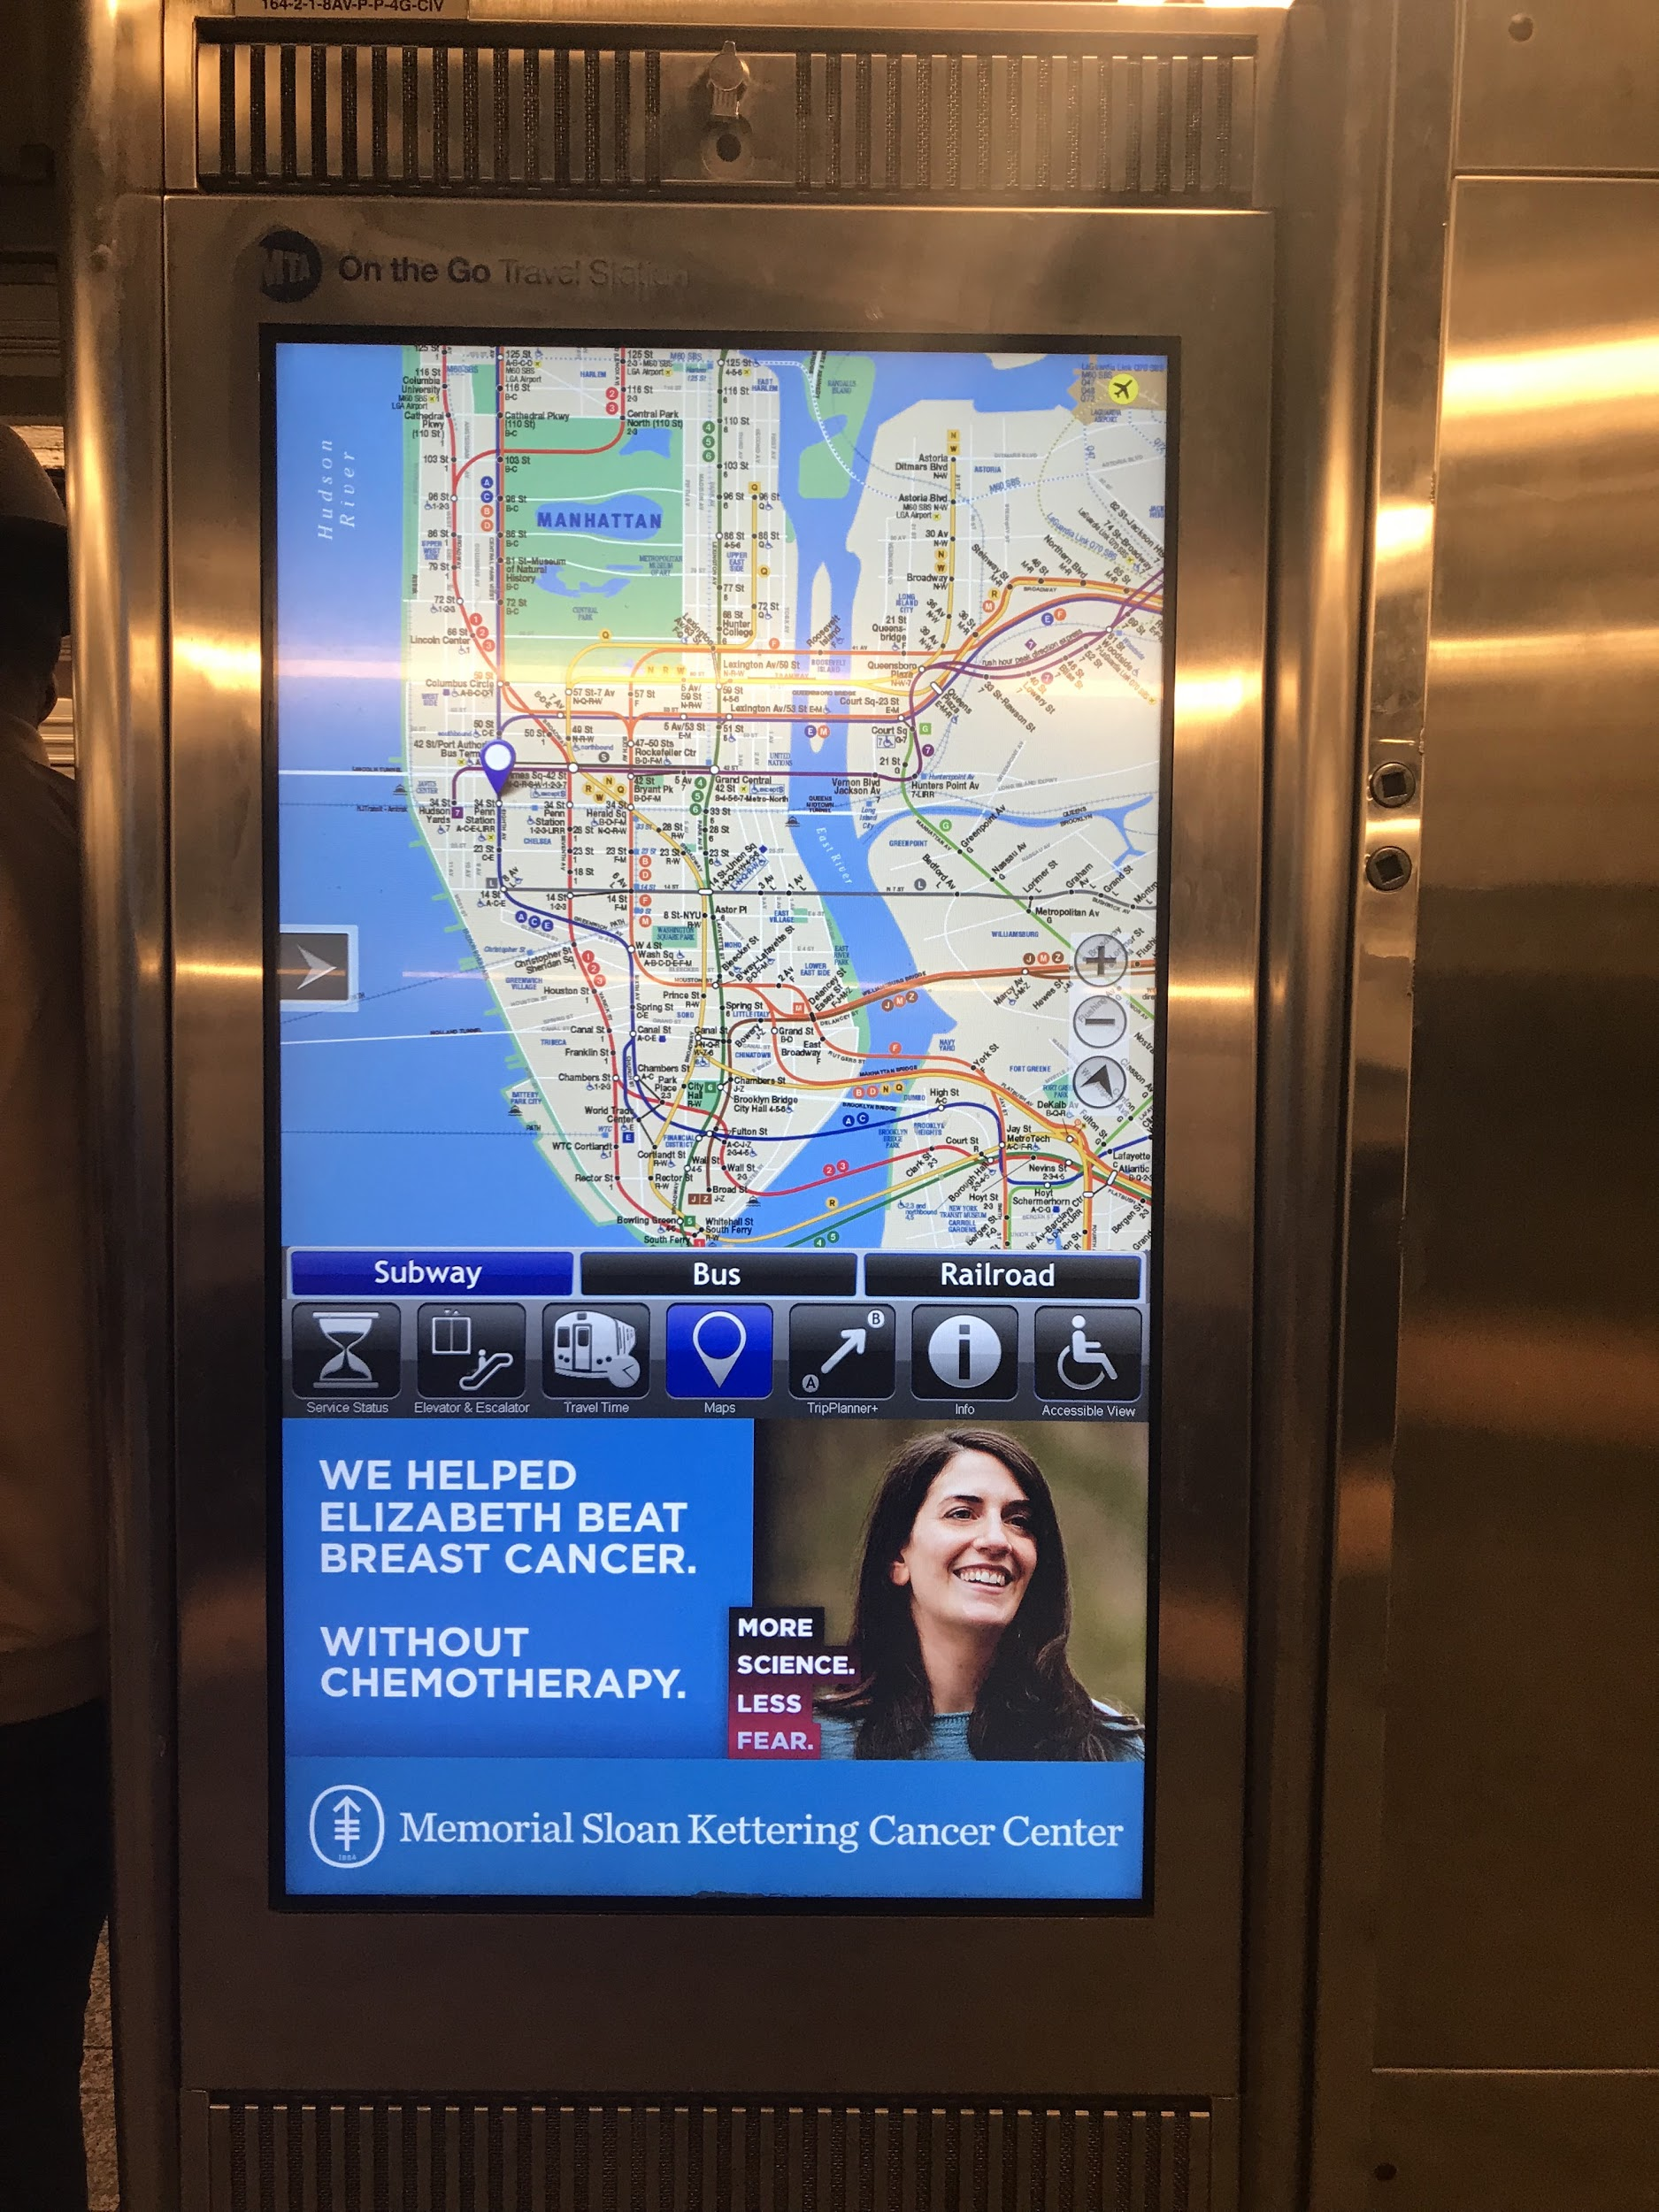
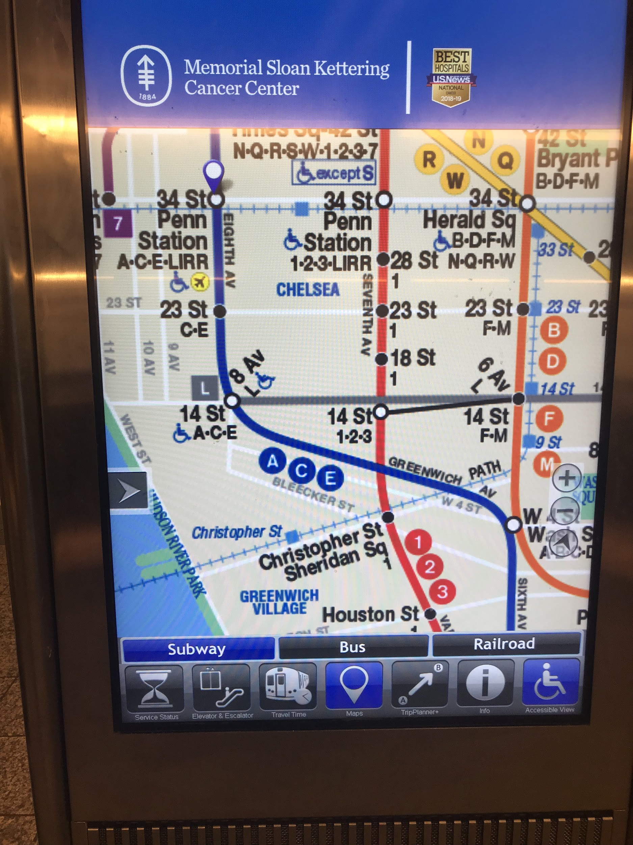
Information Kiosk

Slide 14
Information Kiosk
Should have language selection option.
It should be efficient enough to give weather update.

Slide 15
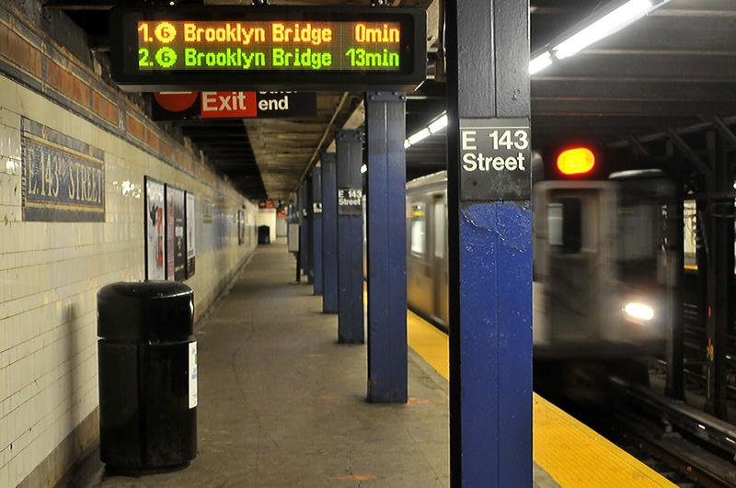
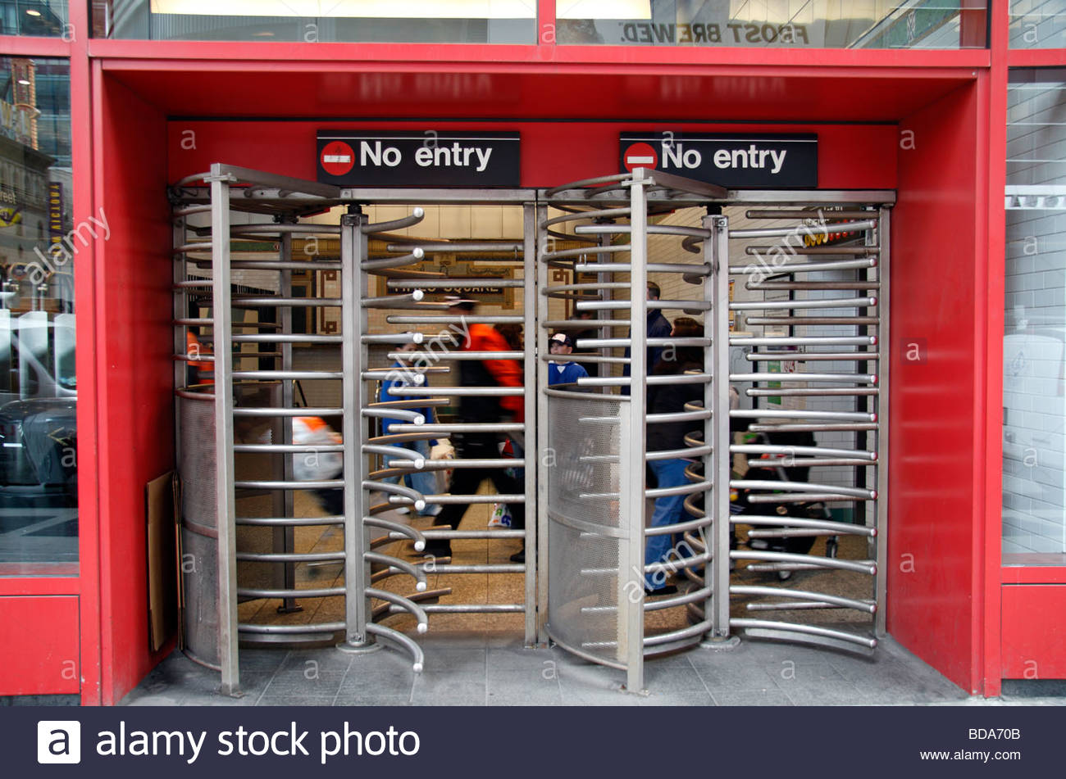
Train platform
Should have more clarified upcoming train schedule
Sign board should be in red colors.
Same entry and exit points.

Slide 16
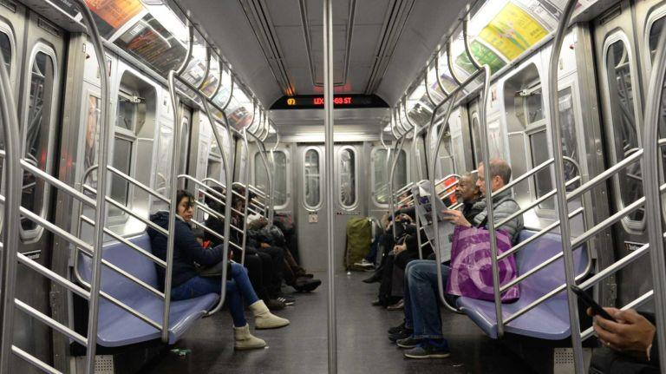
Train car
Screen Scrolling should be shortened
The announcements should be done after every stop.
Should be more handles to hold from top

Slide 17
Thank you
😊

